Slide 1


Firebase
Firebase is a Backend-as-a-Service (Baas). It provides developers with a variety of tools and services to help them develop quality apps, grow their user base, and earn profit. It is built on Google's infrastructure. Firebase is categorized as a NoSQL database program, which stores data in JSON-like documents.

Slide 2

1.
Android Studio to Firebase
Insert, Search, Edit and Delete Data from AS to Firebase Realtime Database

Slide 3
Steps to complete the app:
Create an Android Studio Project
Connect Android Studio Project to Firebase
Add Dependencies
Make an Insert Function
Make a Search Function
Make an Edit and Delete Function
Run to Virtual or Hardware Device
Use the App

Slide 4
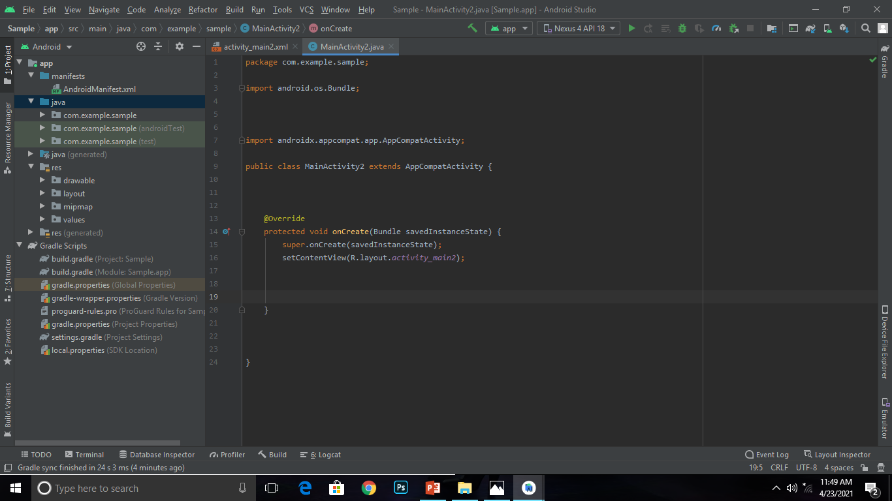
Basic Parts of AS
This is the folder in your project where you will be storing all of the source code files written in Java programming language
This is where you define variables
This is the folder in your project where you separate and sort the resources of your application (ex. xml layout)
Here, you're telling your Activity to load the activity_main.xml layout resource file
This is where Voids, Class, OnCreate and etc. takes place
This is where dependencies and gradle build system takes place

Slide 5
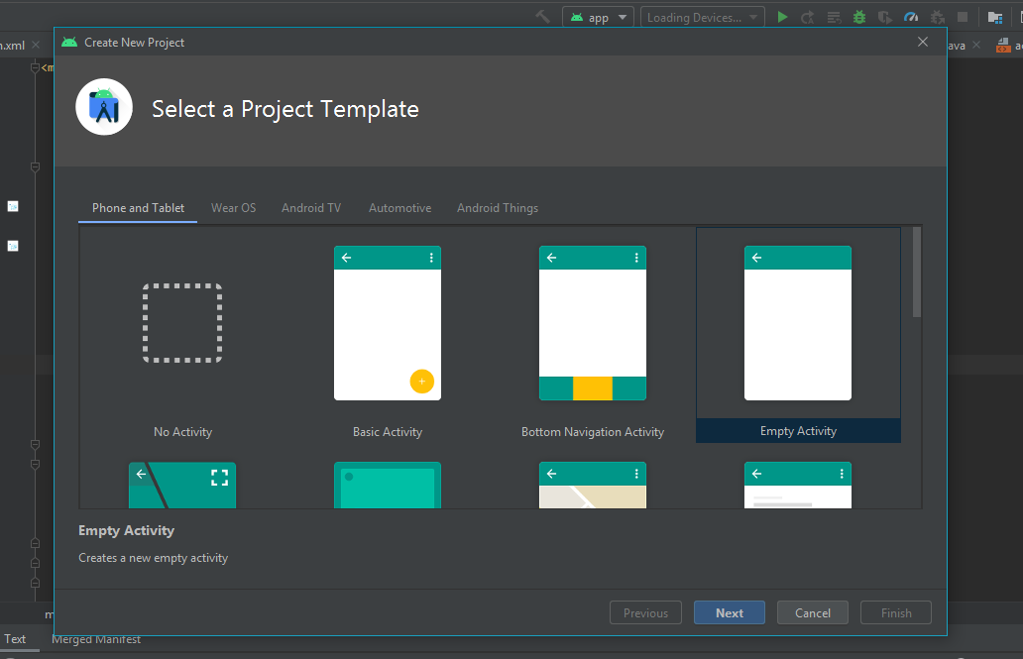
Create an Android Studio Project
Choose empty activity as a starting app.
Place your screenshot here

Slide 6
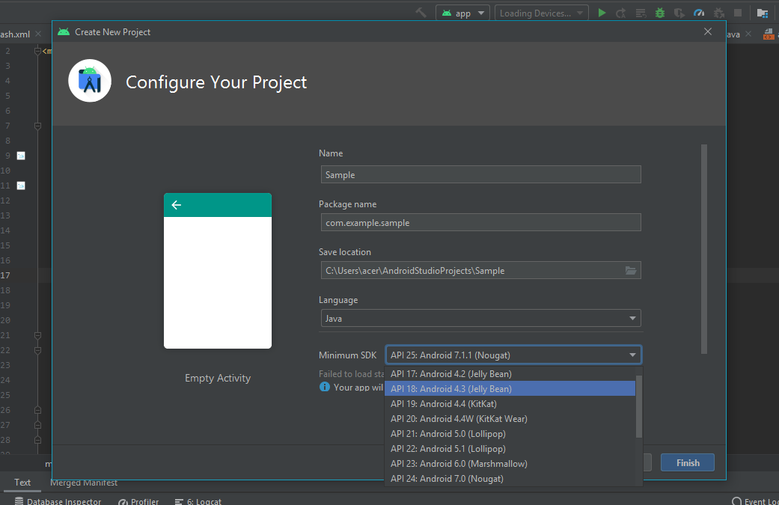
Select Android 4.3 (Jelly Bean) as Minimun SDK and Java as programming language.
Place your screenshot here

Slide 7
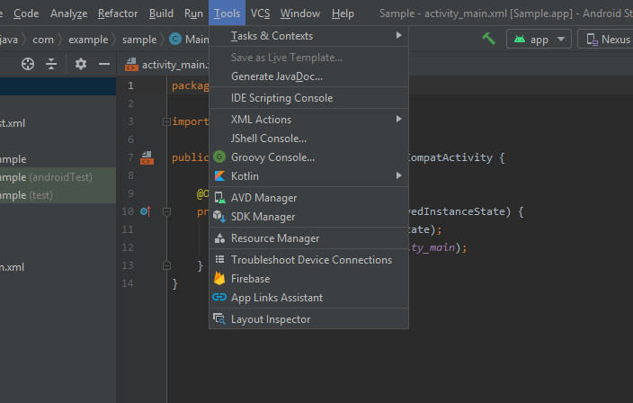
Select the Firebase in Tools panel.
Place your screenshot here

Slide 8
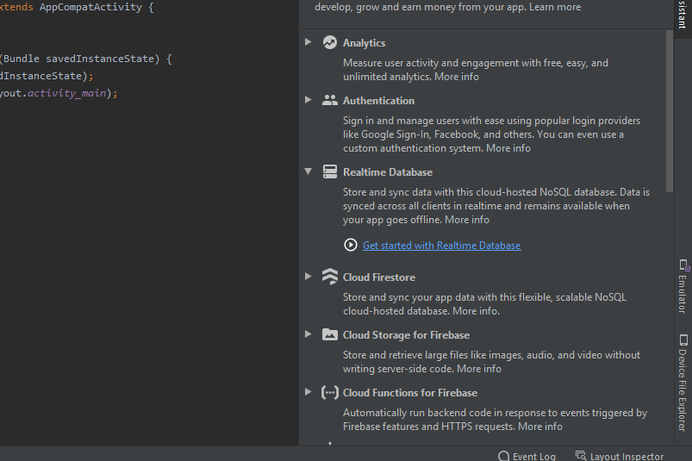
Select Realtime Database in Firebase Assistant Panel.
Place your screenshot here

Slide 9
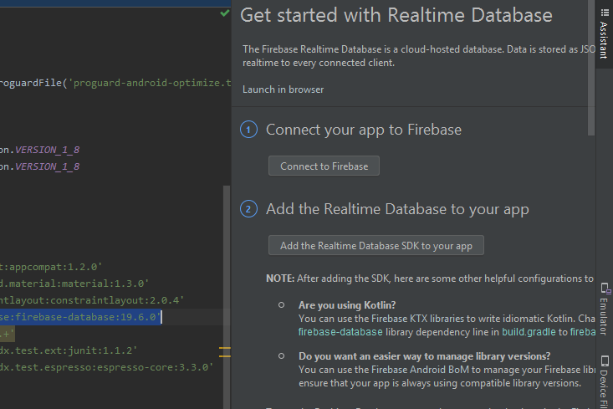
Connect Android Studio Project to Firebase
Select Connect to Firebase and then it will open the default browser.
Place your screenshot here

Slide 10
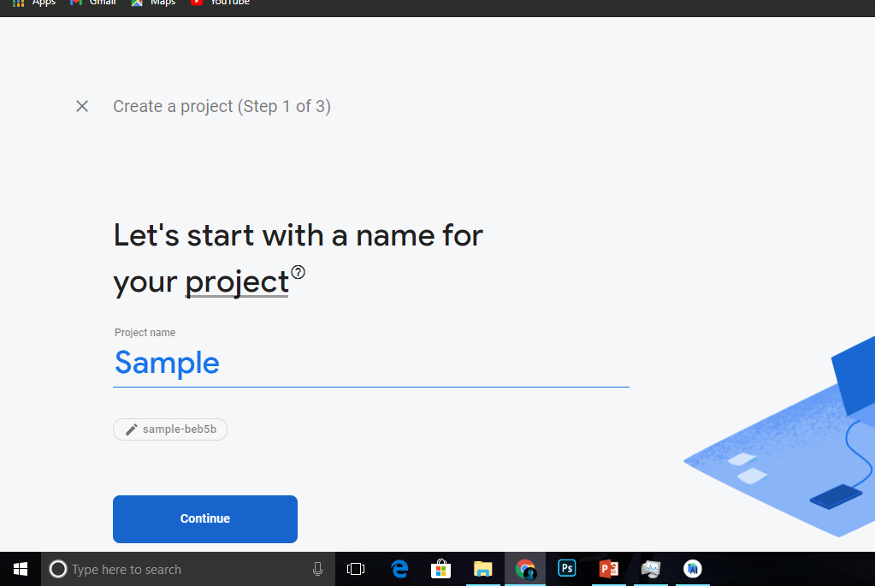
Create a Firebase Project.
Place your screenshot here

Slide 11
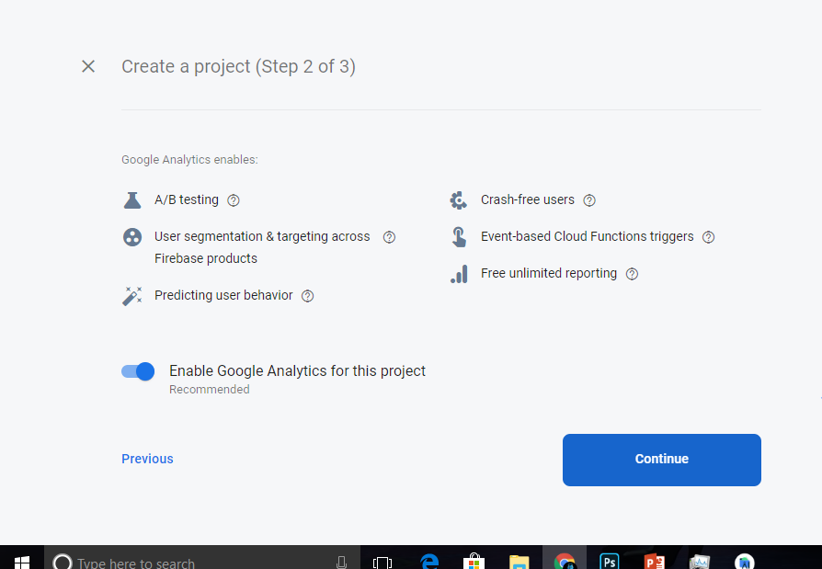
Create a Firebase Project.
Place your screenshot here

Slide 12
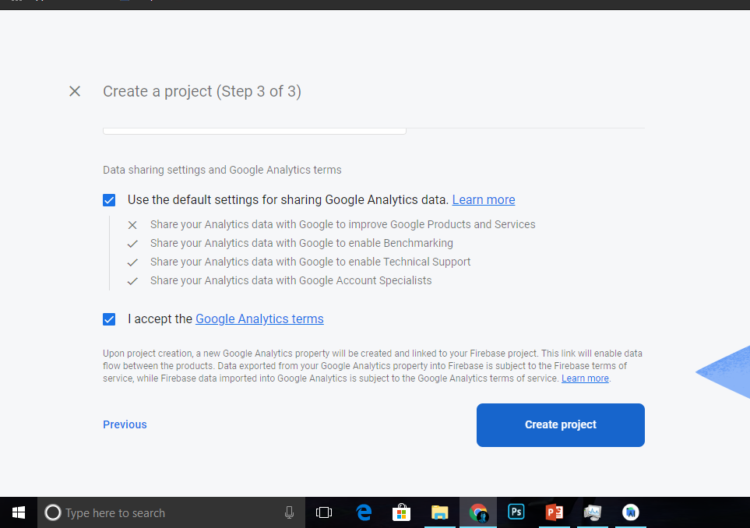
Accept the Google Analytics terms to continue creating the project.
Place your screenshot here

Slide 13
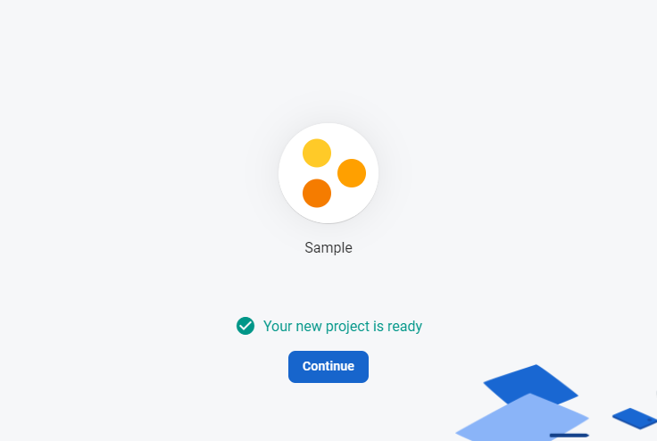
Click continue
Place your screenshot here

Slide 14
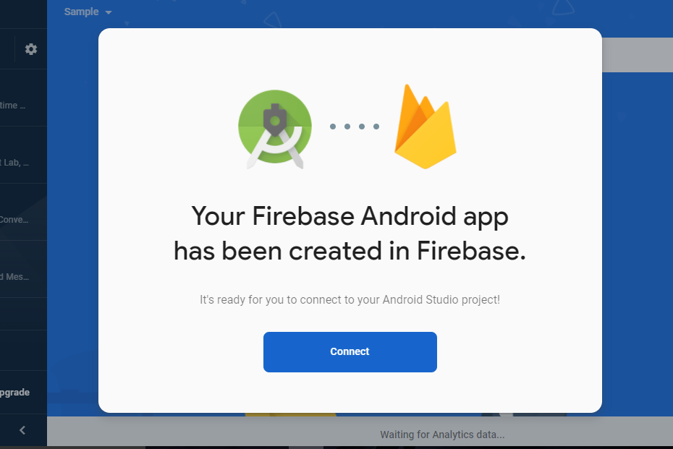
Connect Android App to Firebase.
Place your screenshot here

Slide 15
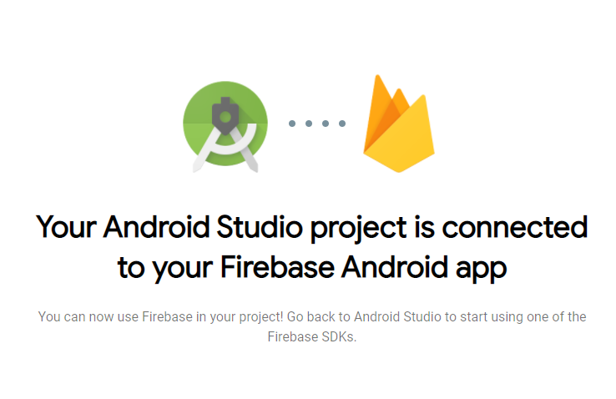
After Android Studio project and Firebase is successfully connected go back to Android Studio.
Place your screenshot here

Slide 16
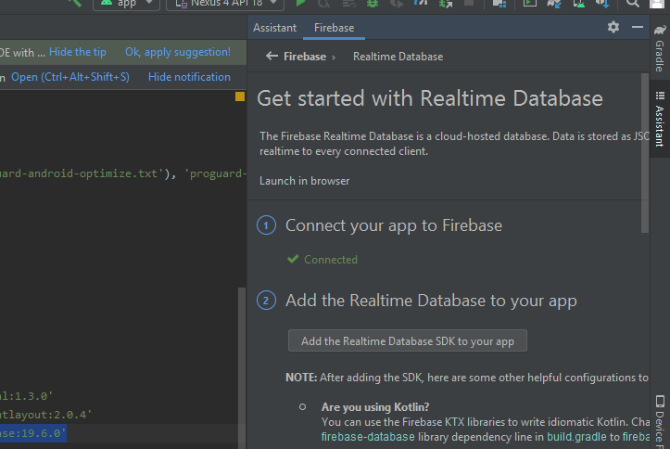
Add the Realtime SDK to your app.
Place your screenshot here

Slide 17
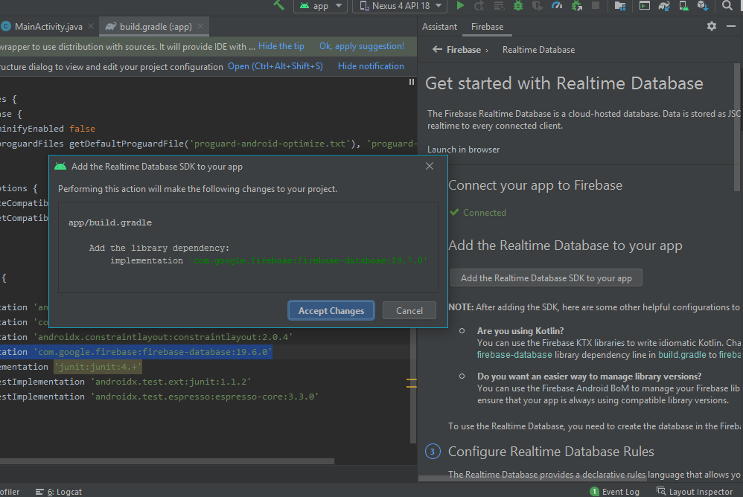
Accept changes and then it will sync dependecies of Realtime Database to your App.
Place your screenshot here

Slide 18
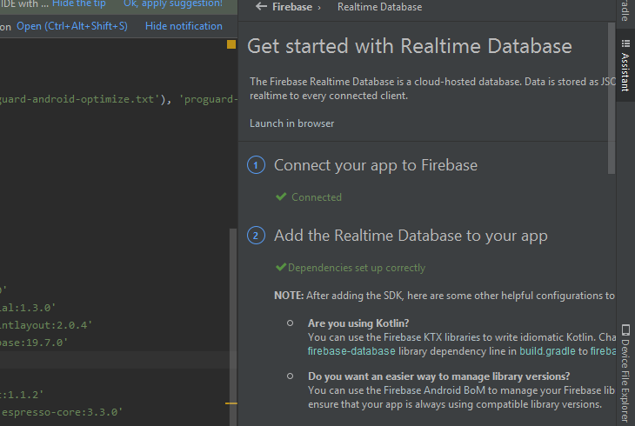
After connecting the app to Firebase and adding Realtime Database depencies into you app, open the Firebase Project.
Place your screenshot here

Slide 19
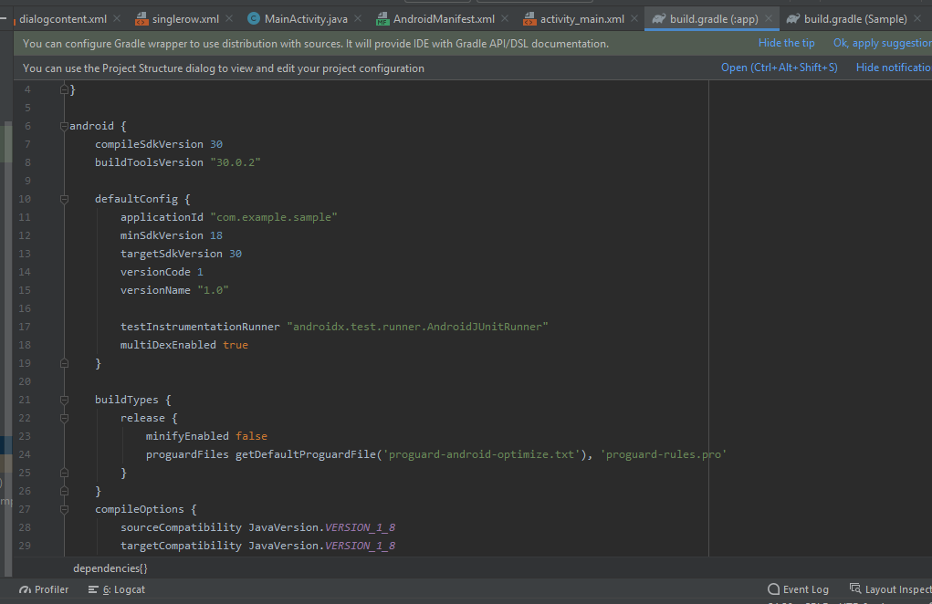
Add Dependencies
As the app go through, this are the gradle build you need. First add multiDexEnabled true under defaulConfig.
Place your screenshot here

Slide 20
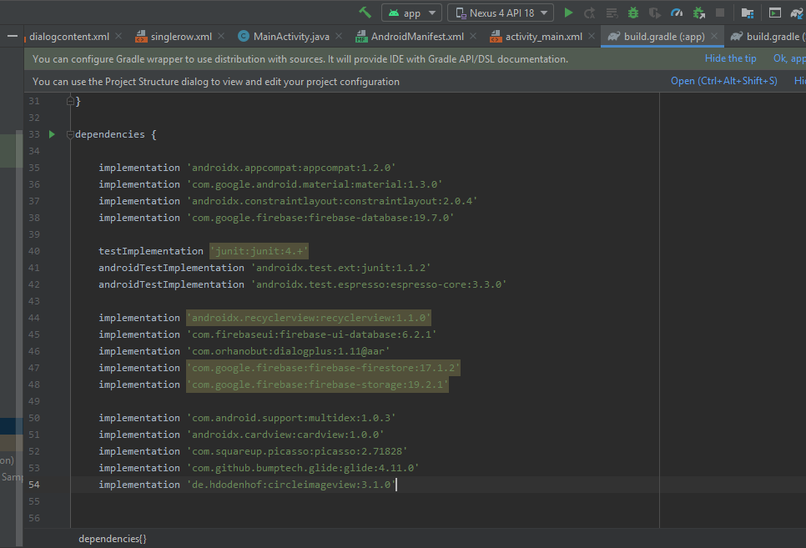
These are the dependencies used in this app.
Place your screenshot here

Slide 21
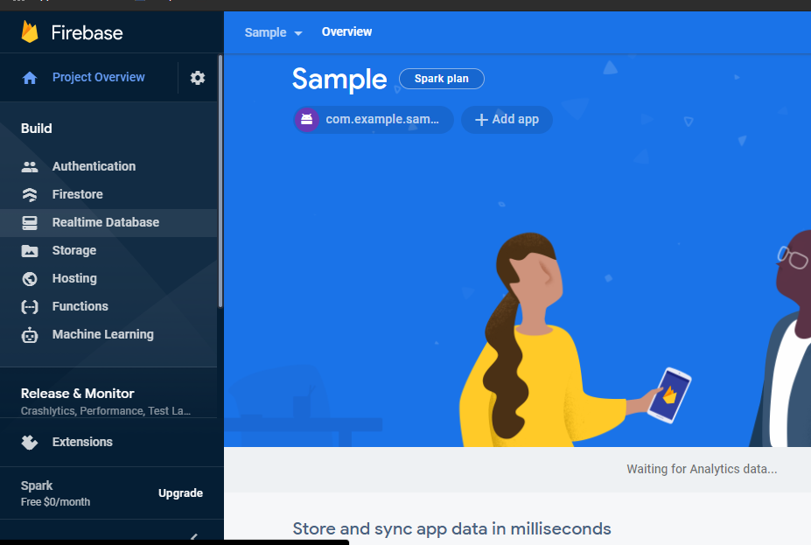
Open the Realtime Database in Firebase project.
Place your screenshot here

Slide 22
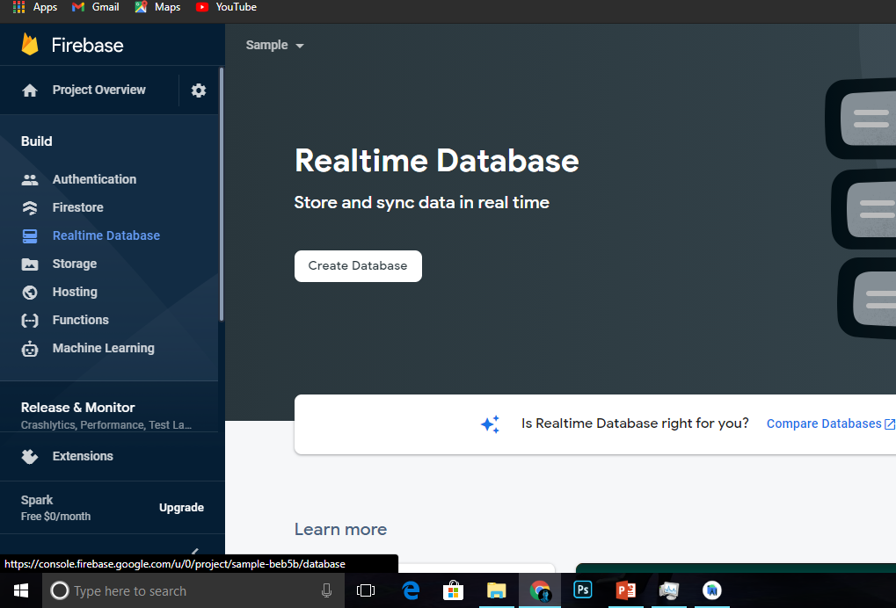
Create Database.
Place your screenshot here

Slide 23
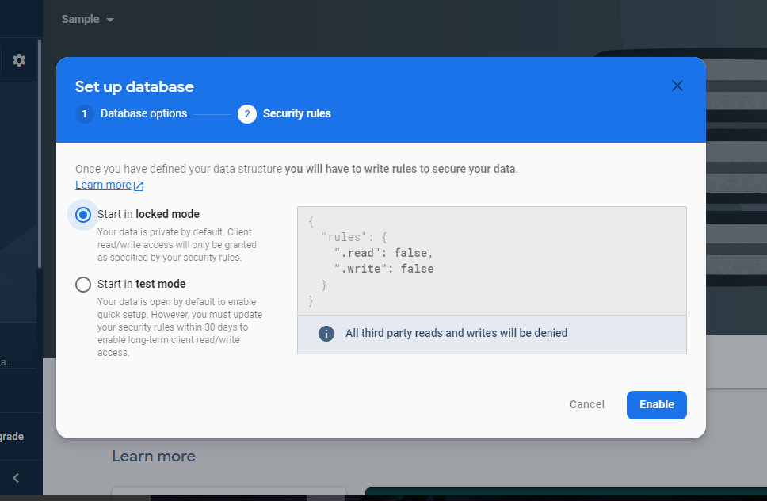
Set up the Database.
Place your screenshot here

Slide 24
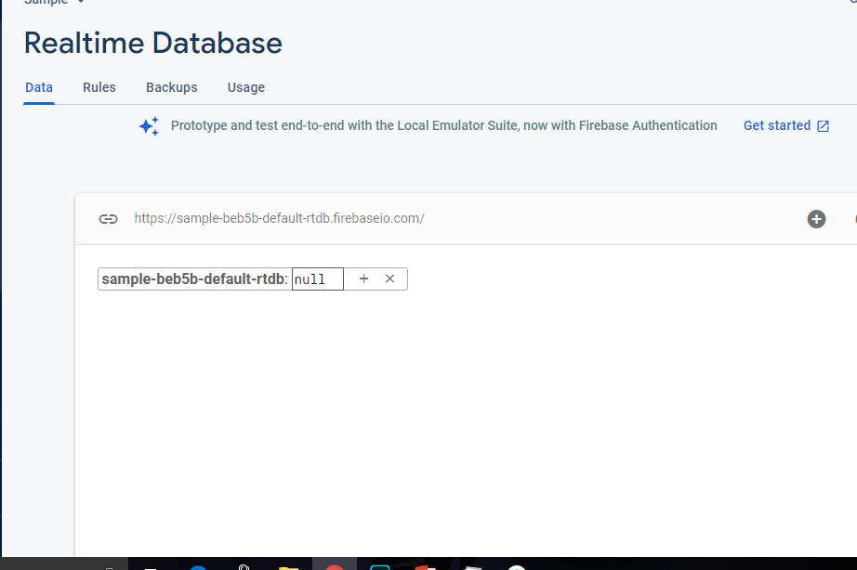
This panel is where the data will be written.
Place your screenshot here

Slide 25
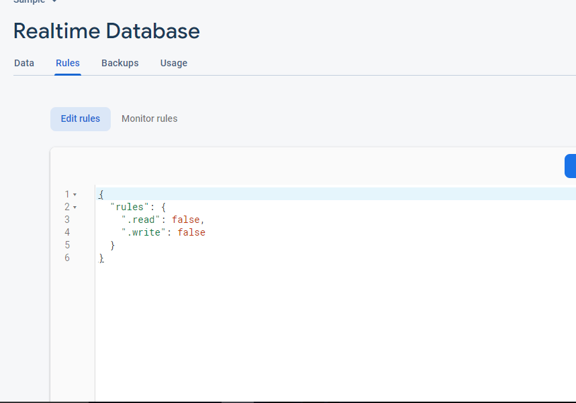
Select the Rules option and edit the rules.
Place your screenshot here

Slide 26
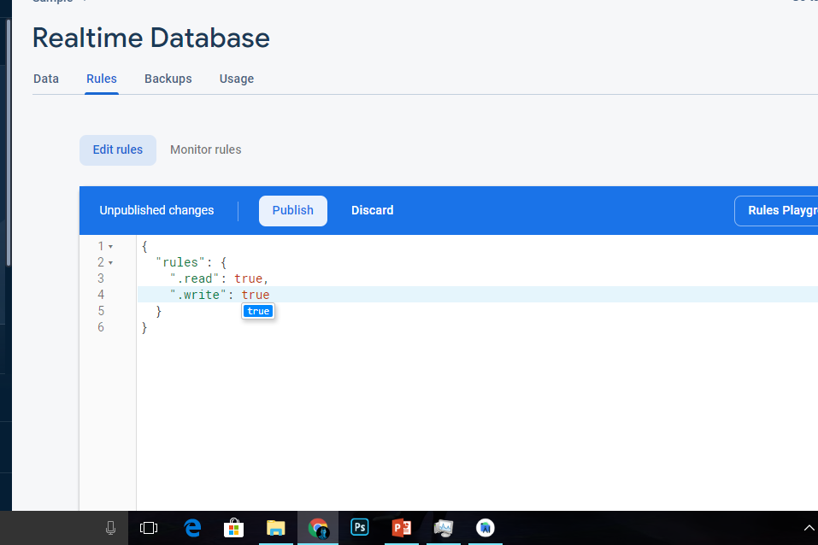
Set the read and write to true. This will allow your app to read and write data to Realtime Database
Place your screenshot here

Slide 27
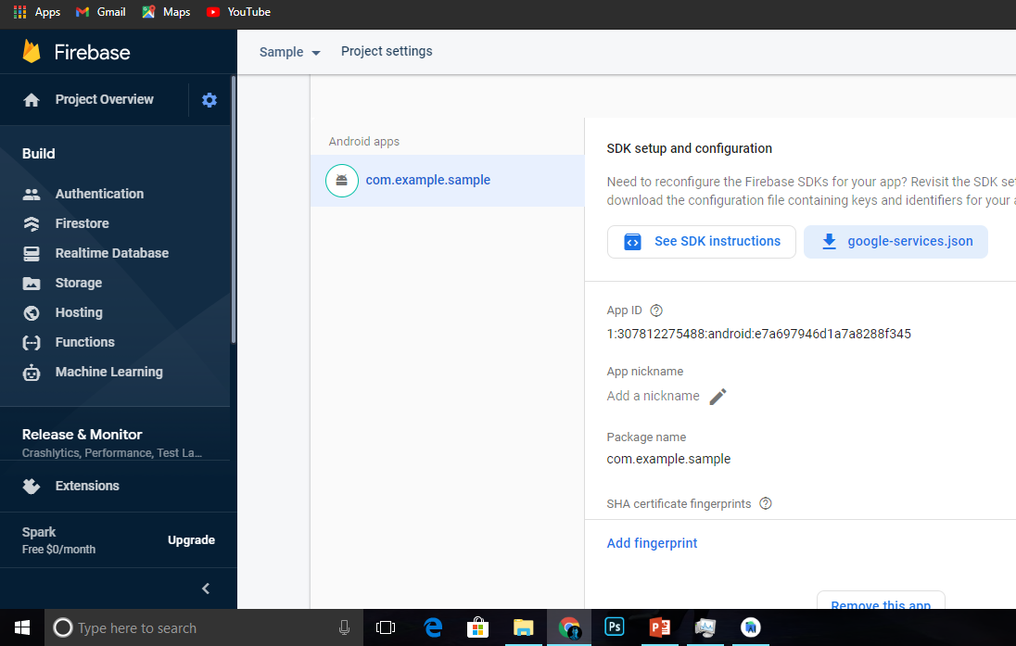
Go to settings and download the google-services.json.
Place your screenshot here

Slide 28
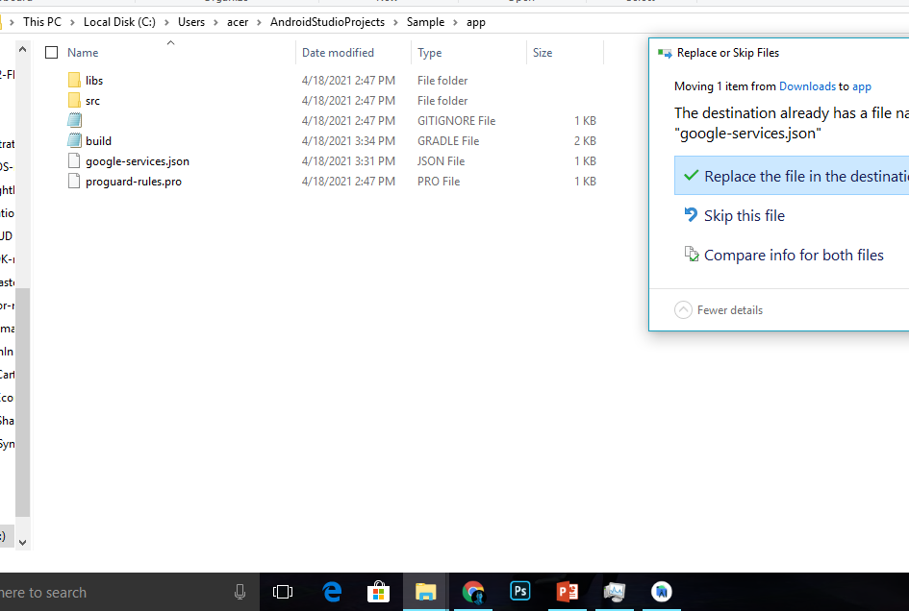
Replace the existing .json file in your app file directory AndroidStudioProjects/Sample/app to update the changes you make in Firebase.
Place your screenshot here

Slide 29
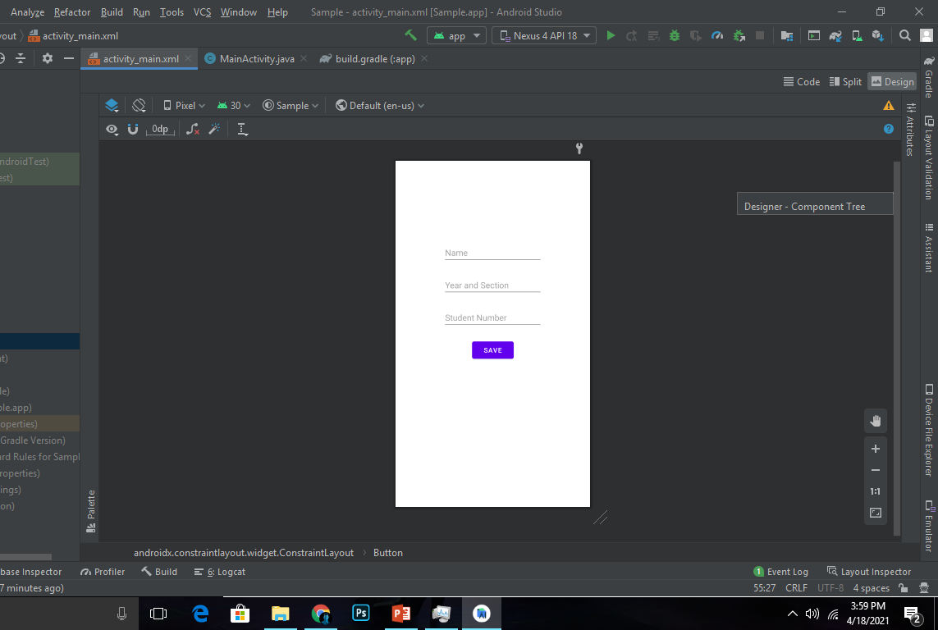
Make an Insert Function
In XML Layout or App Design, add three EditText Views and one Button.
Place your screenshot here

Slide 30
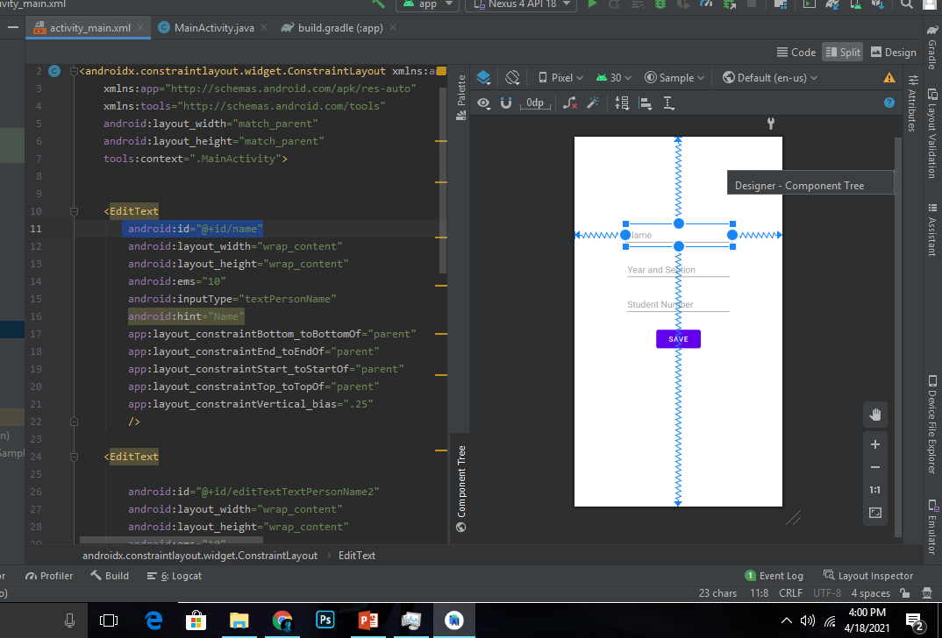
Give Id to EditText Views and Button (ex. name, year, number, save).
Place your screenshot here

Slide 31
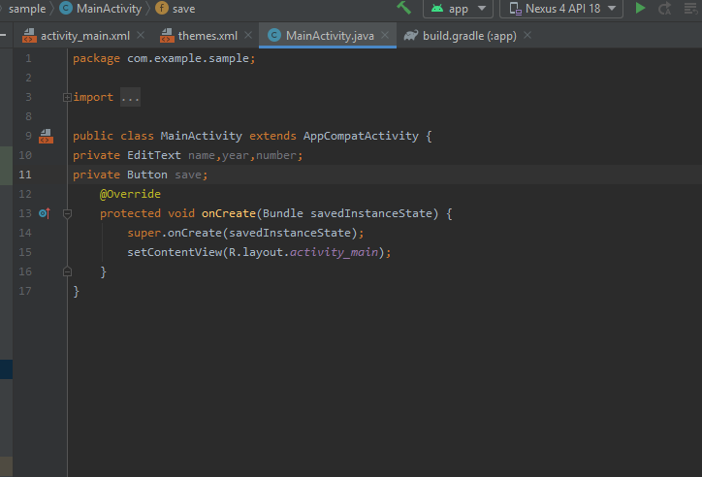
In Java, identify the variables.
Place your screenshot here

Slide 32
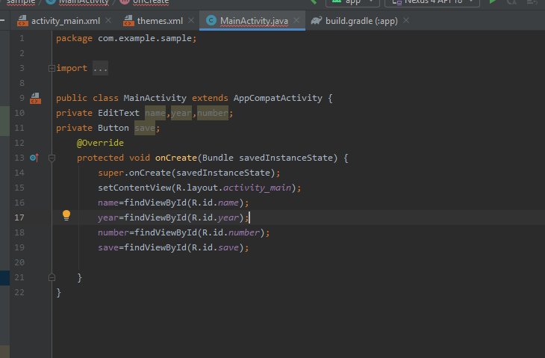
Using findViewById syntax, distribute the views from the layout to the variables.
Place your screenshot here

Slide 33
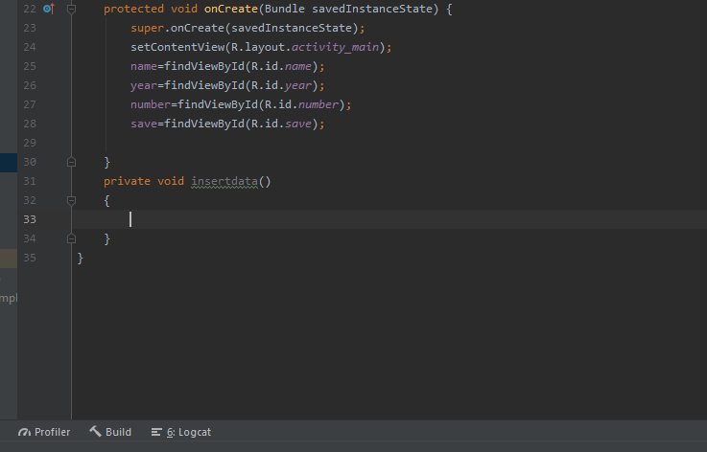
Make a Private Void for inserting data.
Place your screenshot here

Slide 34
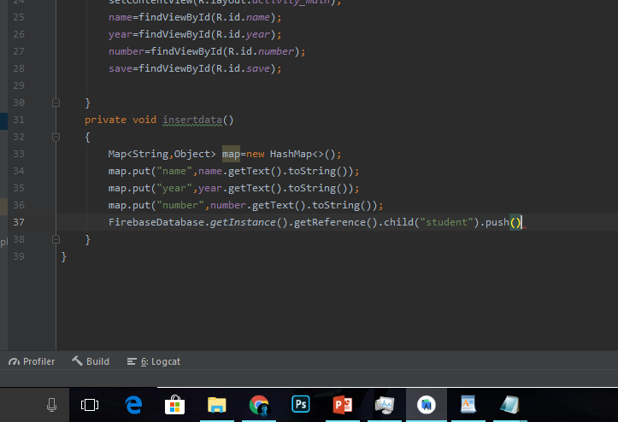
Using HashMap method, the app can map or write data from your app to Realtime Database.
Place your screenshot here

Slide 35
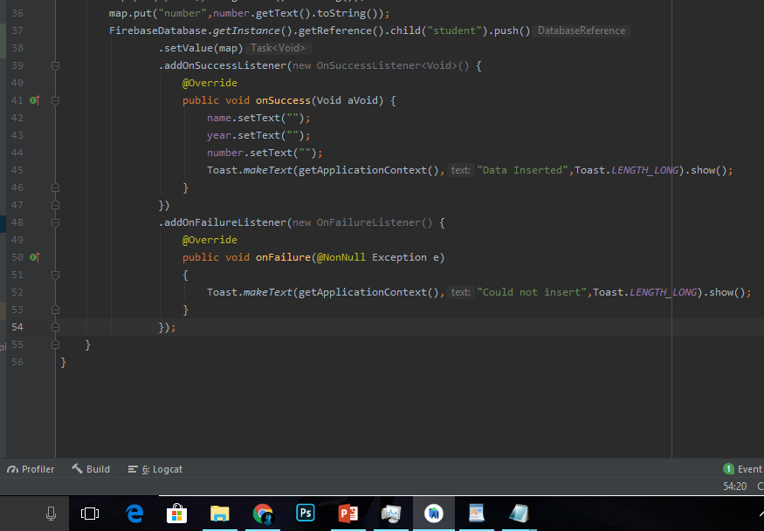
Add OnSucess and OnFailure Listener as your callback in your codes.
Place your screenshot here

Slide 36
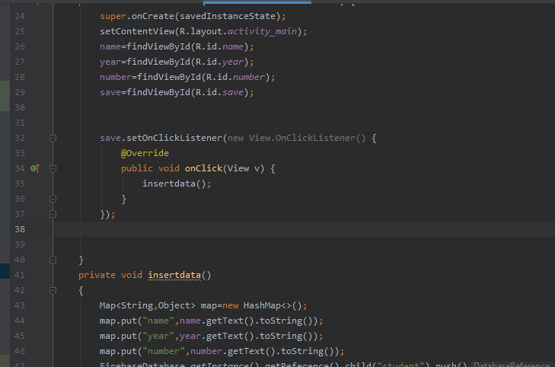
Use setOnClickListener method to your button and insert the void of saving data to Database inside.
Place your screenshot here

Slide 37
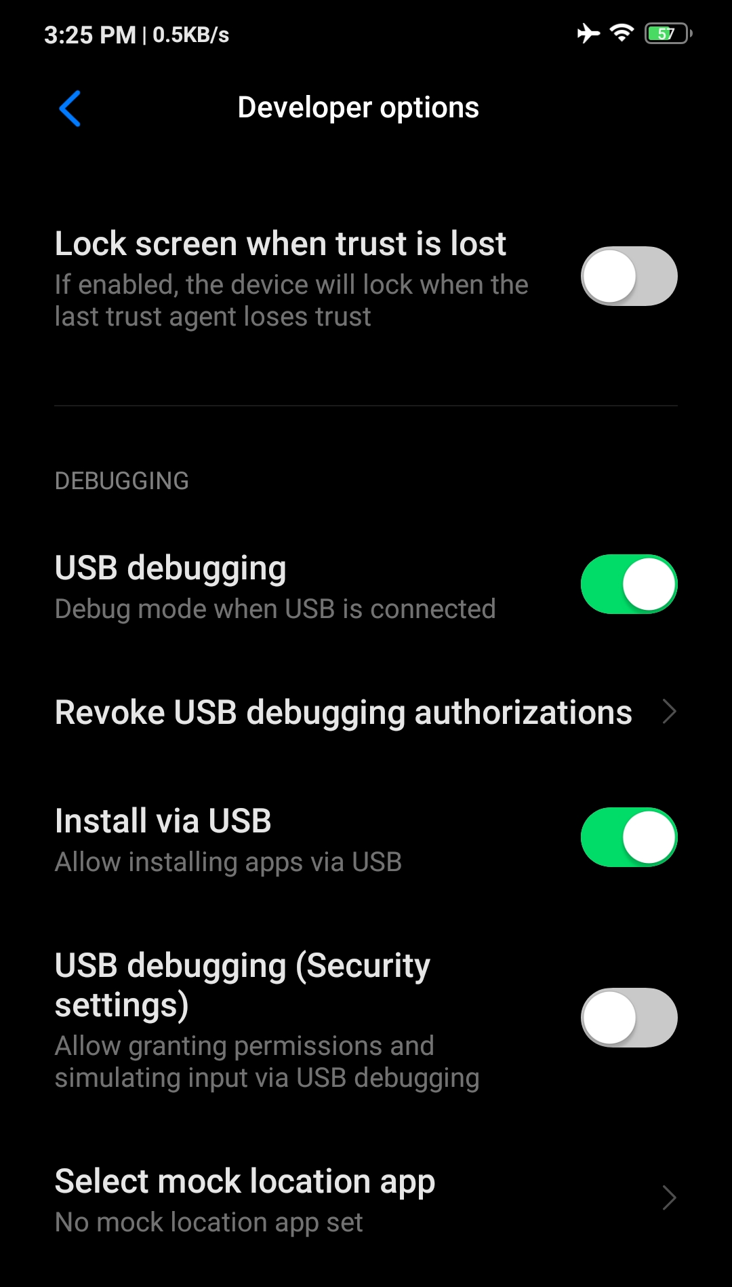
Device Setup
If using a real mobile as a device, turn on the Developer options, USB debugging and Install via USB. Connect the phone using USB cable to the computer.
Place your screenshot here

Slide 38
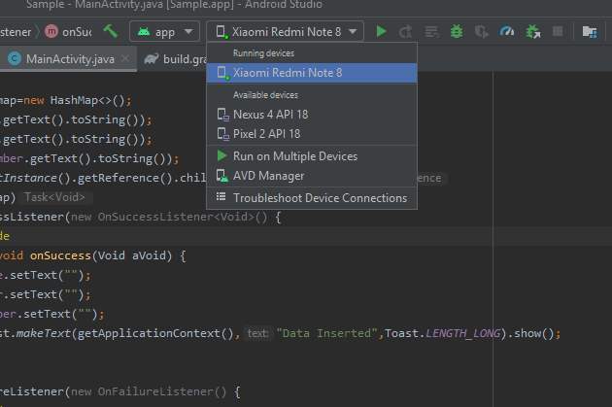
Select a device available (Hardware Device or Virtual Device).
Place your screenshot here

Slide 39
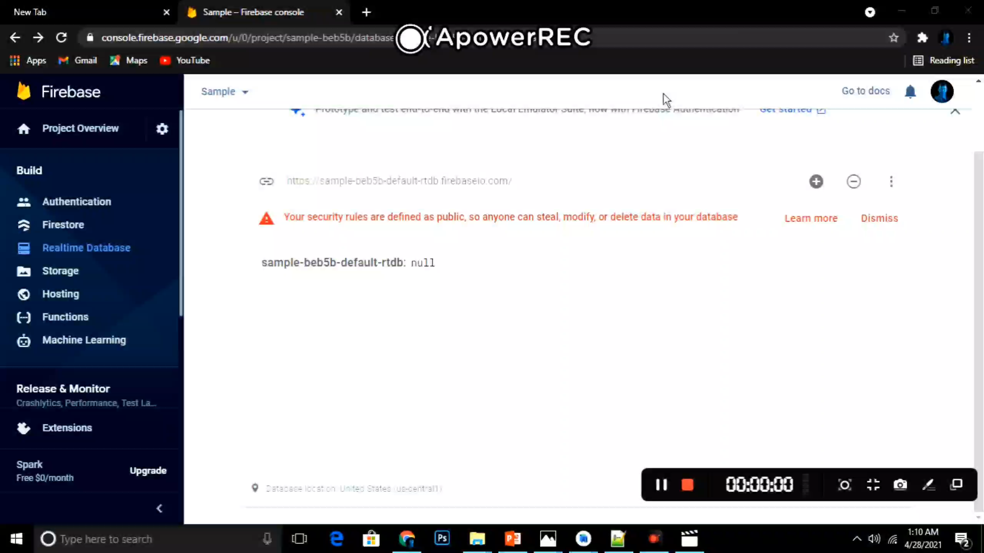
AS Insert Data to Firebase

